Slide 2
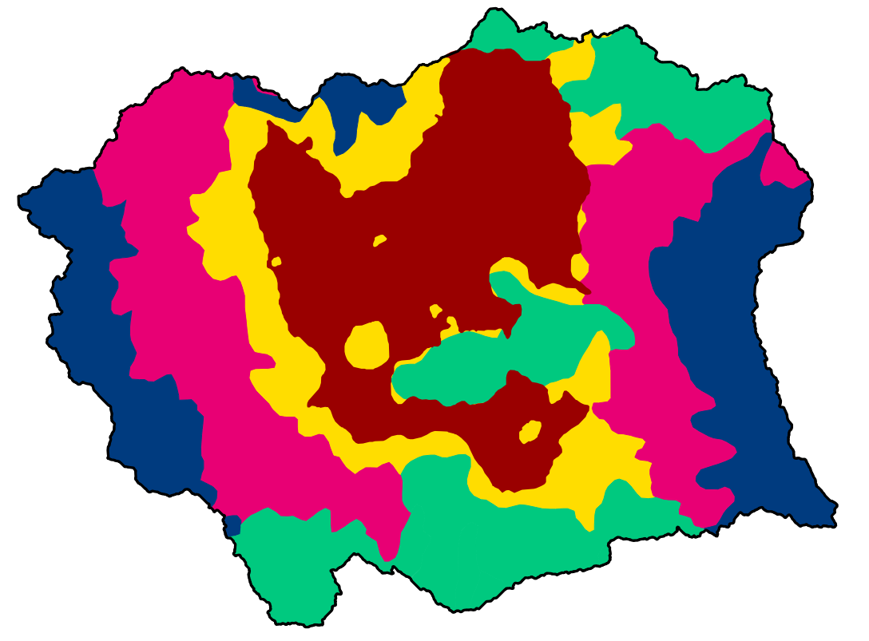
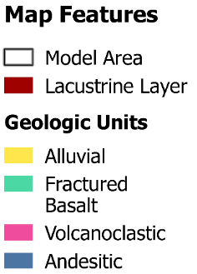
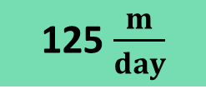

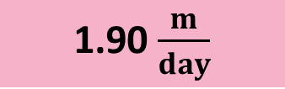
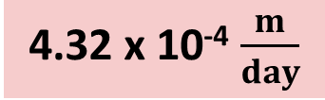
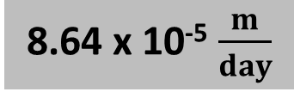
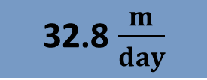
Geology
8.64 x 10⁻⁵ $\frac{m}{day}$
4000
3000
2000
1000
0 masl
4.32 x 10⁻⁴ $\frac{m}{day}$
8.04 $\frac{m}{day}$
32.8 $\frac{m}{day}$
1.90 $\frac{m}{day}$
125 $\frac{m}{day}$
Notes:
The general geology of the basin is described as a high altitude volcanic system with a lake bed in the center of the valley. The model can be simplified into a two layer system. The top layer is a low hydraulic conductivity formation in the center of the valley. The second layer consists of unconsolidated alluvial deposits and fractured basalt in the center of the basin, and volcanoclastic and andesitic formations along the edges of the basin. The lacustrine deposits are relatively low hydraulic conductivity while the productive aquifers range from 1 to 125 meters per day.
I also have a large dataset of time varied pumping quantities distributed throughout the basin. These are concentrated in areas of high population, but also have temporal parameters to try to represent the shift of pumping from the historic downtown area here to the peri-urban areas over time.

Slide 3
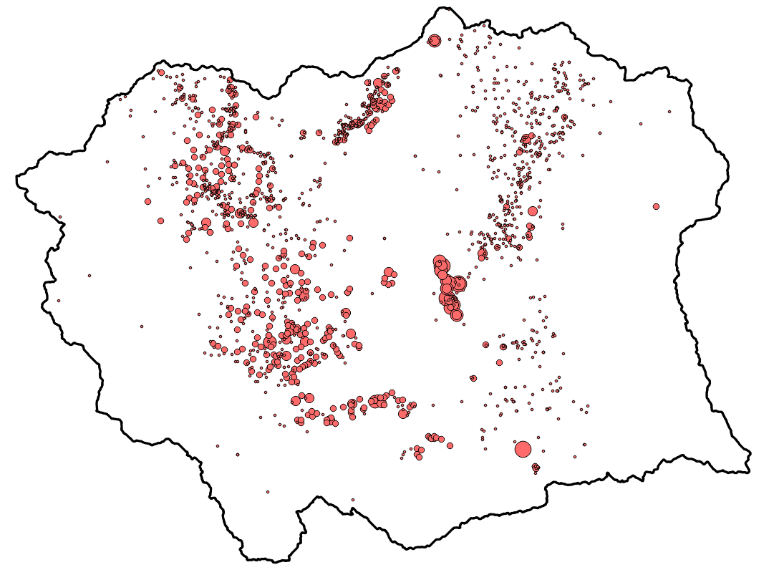
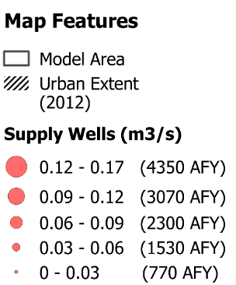
Wells
Notes:
The general geology of the basin is described as a high altitude volcanic system with a lake bed in the center of the valley. The model can be simplified into a two layer system. The top layer is a low hydraulic conductivity formation in the center of the valley. The second layer consists of unconsolidated alluvial deposits and fractured basalt in the center of the basin, and volcanoclastic and andesitic formations along the edges of the basin. The lacustrine deposits are relatively low hydraulic conductivity while the productive aquifers range from 1 to 125 meters per day.
I also have a large dataset of time varied pumping quantities distributed throughout the basin. These are concentrated in areas of high population, but also have temporal parameters to try to represent the shift of pumping from the historic downtown area here to the peri-urban areas over time.

Slide 4
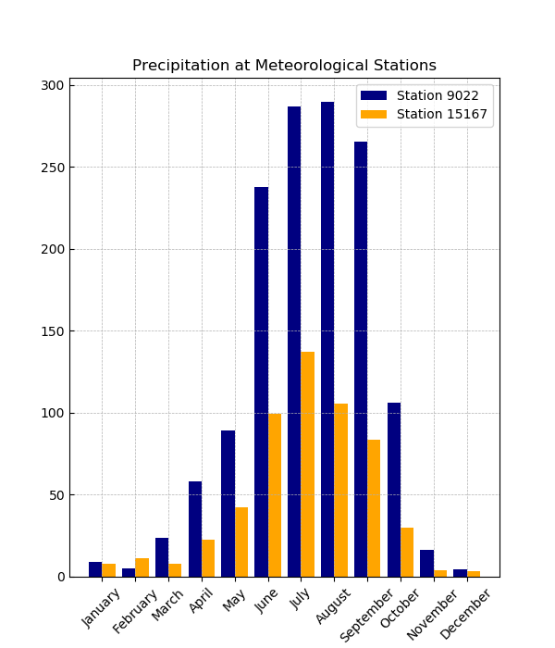
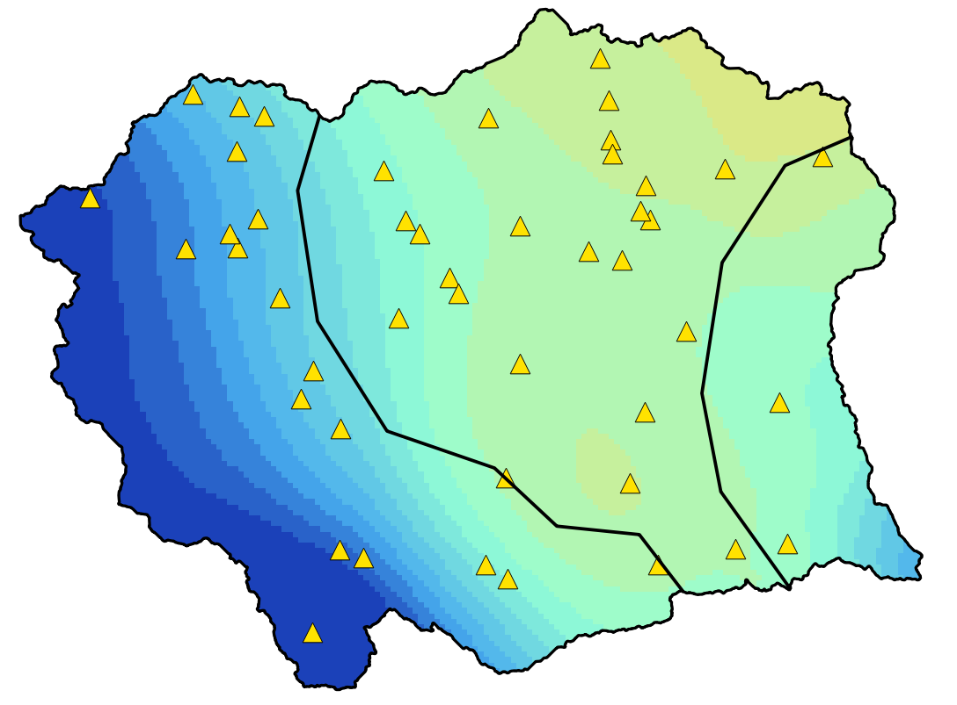
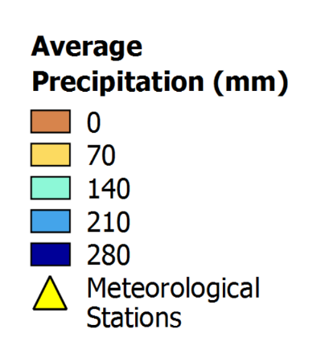
Precipitation
30 Year Average July Precipitation
(Cubic Spline Interpolation)
15167
9022
Intro/Motivation Chapter 1 Chapter 2 Chapter 3 Chapter 4 Conclusion
Notes:
Alternatively, precipitation futures will be generated by evaluating the statistical properties of local precipitation trends combined with projections from downscaled general circulation models. The properties of the basin may require specific alterations to methods proposed in the literature. Spatial as well as temporal considerations for climate futures can be made for this basin. In this basin there are three basic zones for precipitation: west, central, and east. With the mountainous regions receiving significantly more rainfall throughout the year and especially during the wet season.

Slide 5
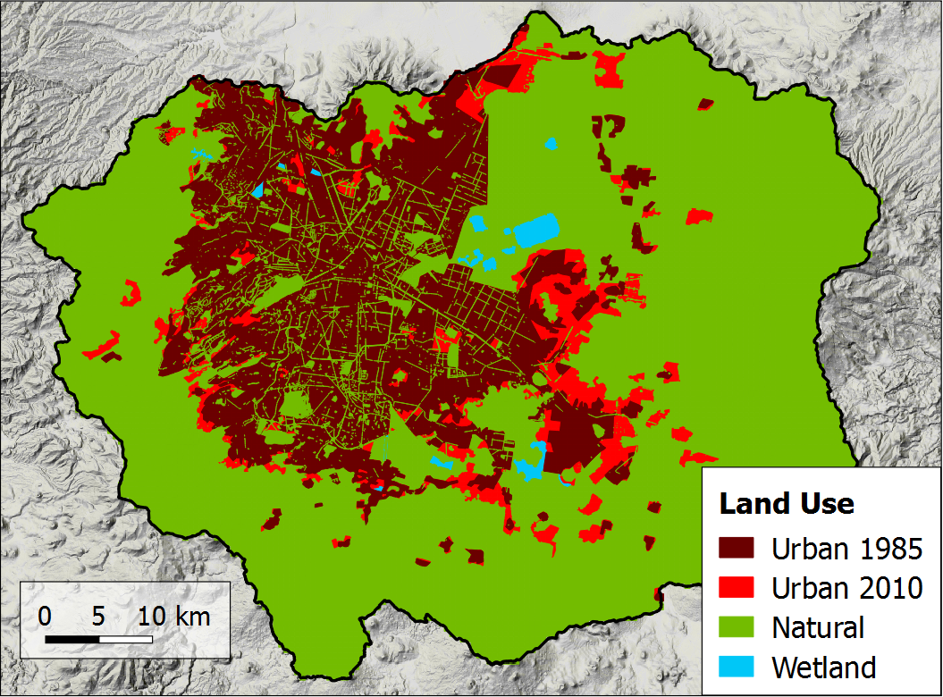
Land Use

Slide 6
